Slide 1

A Winning Digital Campaign for Conner MAC
Empower your Vision with our Expertise

Slide 2





INTRODUCTION
Imagine a campaign where every dollar spent amplifies your voice, where every advert
resonates with the right audience, and every interaction converts a potential voter into a loyal supporter.
Conner Mac’s vision for a better future deserves a platform that reaches, engages, and mobilizes voters effectively.
Our innovative digital marketing strategy is designed not just to compete but to win. Here's why Conner Mac's campaign needs our expertise.

Slide 3



THE POWER OF DIGITAL
choose us
In today’s fast-paced digital age, traditional campaigning methods like GOTV are longer sufficient. Here’s how we transform your $1.2 million budget into a
powerful, results-driven digital campaign:

Slide 4
Wide and Diverse Reach:
Inclusivity: We connect with diverse groups, including religious
communities, young voters, ethnic minorities, and underrepresented
demographics who are highly active online but often overlooked in
traditional campaigns.
2. Personalized Messaging:
Data-Driven Insights: By analyzing detailed voter data, we tailor messages that resonate with specific demographics, ensuring higher engagement participation.

Slide 5

choose us
3. Higher Return on Investment
Efficient Budget Allocation: Digital advertising provides more bang for your buck when compared to traditional methods, ensuring maximum impact and voter reach.
Our strategies ensure that your budget is allocated efficiently, reaching the maximum number of voters with
impactful messaging and subsequently resulting in winning their votes.
4. Innovative and Impactful Strategies:
Fresh Approaches: Our innovative strategies align with your desire to make a significant impact, offering dynamic ways to engage voters and drive results. We understand that you want to do something different and more impactful with your campaign budget.

Slide 6

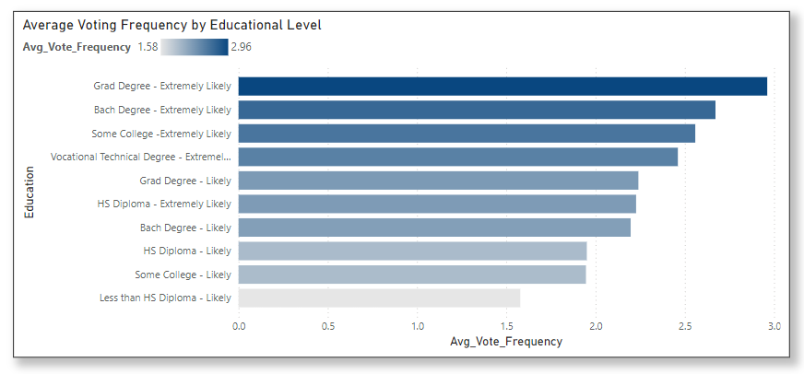
Target Audience Analysis
Using our data-driven insights, we’ve identified key demographic segments with high potential for voter engagement. Here’s a breakdown:
1. Educational Levels:
High Engagement
Fayette County data shows that highly educated
individuals, including those with graduate, bachelor, vocational, and
technical degrees, show higher voting frequencies. This demographic
tends to be concerned with job creation and vocational opportunities,
making them politically engaged.
Fig 1: Average voting frequency by voter educational level

Slide 7
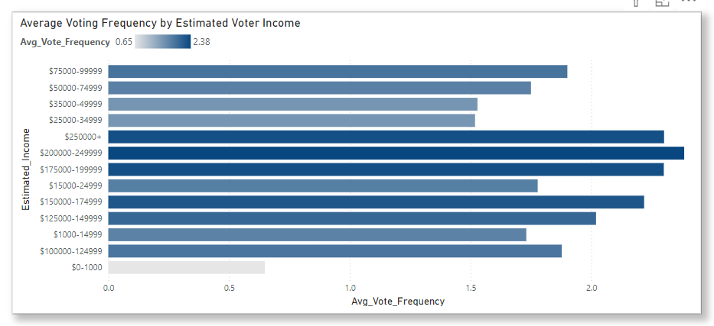
2. Income Bracket
Fig 2: Average voting frequency by Estimated voter Income
Mid and Low-Income Earners:
Data reveals that mid-income earners ($75,000 - $250,000+) and low-income earners ($15,000 - $75,000) demonstrate significant voting frequencies. Engaging mid-income earners who vote regularly is crucial.
Additionally, young working-class voters (ages 18-35) in the low-income range, who are underrepresented in voter turnout but highly active online, can be targeted with compelling digital content focusing on practical issues such as healthcare, job security, and economic stability.

Slide 8

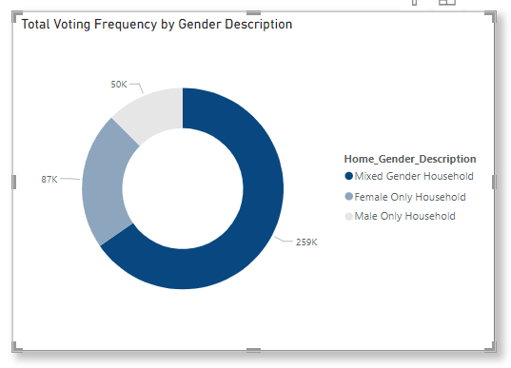
3. Gender
Fig 3: Total voting frequency by Household Gender
Mixed Households and Female Voters:
Mixed-gender household and female-only households show high engagement, with women, particularly in suburban areas, being swing voters.
Targeting them with issues related to healthcare, education, and family welfare can effectively capture their votes.

Slide 9

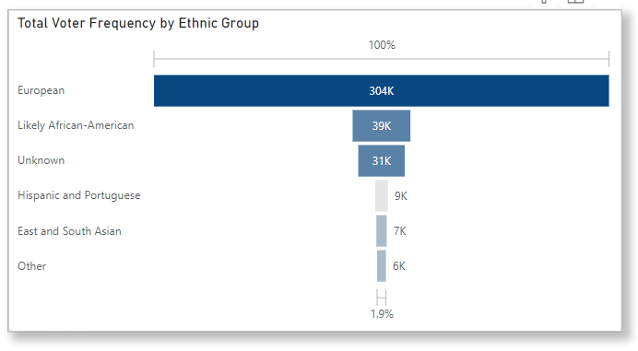
4. Ethnic Groups
Diverse Communities:
European ethnicity voters make up a significant
percentage of the voting population in Fayette County.
Tailoring our campaign to address their interests is logical.
Additionally, creating inclusive adverts for African Americans and Hispanics, emphasizing the unique challenges these communities face, will help boost their
engagement and participation
Fig 4: Total voting frequency by Ethnic Group

Slide 10

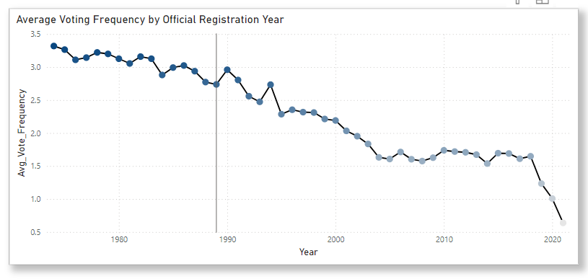
5. Voter Registration Age
Old and New Voters:
Voters with older registrations tend to vote more frequently than newly registered voters.
Engaging both long-registered voters who have shown consistency and newly registered, tech-savvy young voters, who are highly responsive to digital media, can increase turnout and build long-term loyalty.
Fig 5: Average voting frequency by Official registration Year

Slide 11
Strategies and Channels
To maximize reach and engagement, we propose a strategic mix of streaming services,
search, video, and banner advertising. Here’s the detailed plan:
Streaming Services (OTT) Advertising:
Target Audience: Highly educated, high-income individuals, and
households with children.
Ad Types: Family-oriented messages highlighting Conner Mac’s policies
on education, healthcare, and economic stability on platforms like Hulu,
Roku, and YouTube TV.
Budget Allocation: $400,000 for 10 million impressions.
Rationale: Streaming adverts on OTT platforms are highly effective for
targeting young, high-income, and highly educated households. The use
of testimonials and endorsements from relatable figures is also important.

Slide 12
2. Search Advertising
Target Audience: All identified segments, focusing on high-frequency
voters and undecided independents.
Ad Types: Text ads on Google and Bing promoting voting information,
Conner Mac’s stances, and local event participation.
Budget Allocation: $200,000 (Pay-per-click model).
Rationale: Search adverts will target all identified segments, promoting
voting information and addressing specific issues these voters care about, such as economic policies and social justice.

Slide 13
3. Video Advertising:
o Target Audience: Women, ethnic groups, and educated individuals.
o Ad Types: Short, impactful videos on YouTube and social media platforms featuring endorsements, policy highlights, and calls to action.
o Budget Allocation: $300,000 for 15 million impressions.
o Rationale: Video adverts are a powerful medium for delivering impactful messages. These adverts will target women and ethnic minorities, reinforcing Conner Mac’s key messages and encouraging voter turnout.
4. Banner Advertising:
o Target Audience: General public, specifically high-density voting areas.
o Ad Types: Display ads on social media and relevant websites emphasizing the importance of voting and Conner Mac’s key policies.
Budget Allocation
$300,000 for 30 million impressions.
o Rationale: Banner adverts will target high-density voting areas and young voters, emphasizing the importance of voting and Conner Mac’s key policies, ensuring broad visibility and engagement

Slide 14
Given the CPMs provided (Banner $10, Video $20, OTT $40), we propose the following budget breakdown to maximize reach and effectivenesst
:
Add a little bit of body text
Fig 6: Budget Allocation Table
Fig 7: Audience Allocation Table

Slide 15


Conclusion:
This digital campaign strategy is designed to elevate Conner Mac’s candidacy by
leveraging innovative digital approaches to engage key voter demographics effectively.
By combining the strengths of streaming, search, video, and banner advertising, and optimizing budget allocation, we ensure that Conner Mac stands out and resonates with voters, surpassing traditional GOTV methods.
Let’s transform your vision into victory. Together, we can make Conner Mac’s campaign a success!

